Slide 1
NUCLEAR CHEMISTRY
Book Name: Physical Chemistry
Author Name: Arun Bahl, B.S. Bahl, G.D. Tuli
Page number 103-138

Slide 2
Nuclear chemistry is the sub discipline of chemistry that is concerned with changes in the nucleus of elements. These changes are the source of radioactivity and nuclear power.
Nucleons
two subatomic particles that reside in the nucleus known as protons and neutrons are called Nucleons.

Slide 3
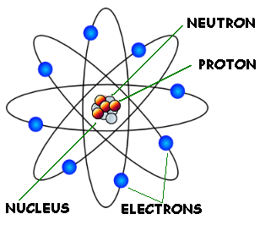
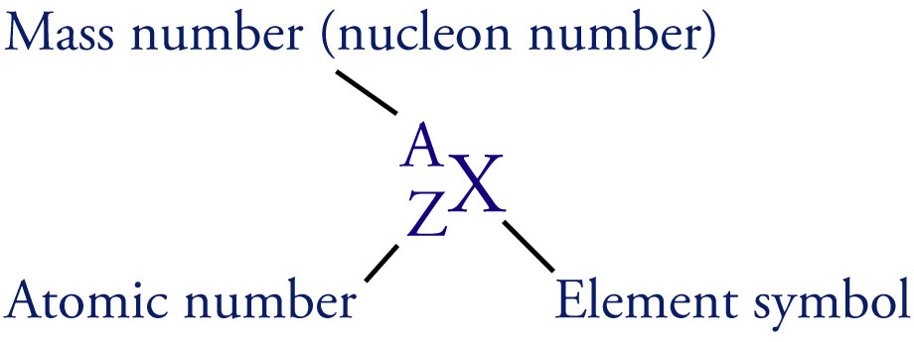

Slide 4
Nucleons-The Sub-Atomic Particles
Not present in stable atoms.
The unit of mass is atomic mass units (a.m.u.), defined by setting the mass of the isotope to exactly 12.
1 a.m.u. = 1.66 x 10⁻²⁷ kg.

Slide 5
Nuclides and Isotopes
The composition of any nucleus is defined by two numbers.
The atomic number is the number of protons in the nucleus.
This defines the chemical nature of the atom.
It is equal to the total charge on the nucleus.
The mass number is the total number of nucleons (protons and neutrons) in the nucleus.
E.g. has an atomic number of 6 and a mass number of 12.
A nuclide is an atom with a particular mass number and atomic number.
Nuclei with the same atomic number but different mass numbers are called isotopes.

Slide 6
Nuclides and Isotopes
Nuclei with the same atomic number but different mass numbers are called isotopes.
E.g. Carbon may exist as a number of isotopes
Unstable nucleus; prepared by nuclear reaction in a cyclotron.
Stable nucleus; accounts for 98.89% of natural carbon.
Stable nucleus; accounts for 1.11% of natural carbon.
Unstable nucleus; trace amounts present in living matter.
Unstable nucleus.

Slide 7
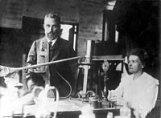
History
Radioactivity was discovered in 1896 by the French scientist Henri Becquerel, while working on phosphorescent materials.
Rutherford and his Student where first to realize that many decay processes resulted in transmutation
Radioactive Displacement law of Fajjans And Soddy were Formulated to Describe alpha and Beta Decay.

Slide 8
Radioactivity
Some atoms are unstable and it’s atomic nucleus breaks of its own accord to form a smaller atomic nucleus of another element. This causes the release of excess particles and energy from the original nucleus, which is called radiation.
The elements whose atomic nucleus emits radiation are said to be radioactive.
The spontaneous breaking down of the unstable atoms is called Radioactive disintegration or radioactive decay.
The disintegration or decay of unstable atoms accompanied by emission of radiation is called Radioactivity.

Slide 9
Natural Radioactivity
Occurs in nature
Usually large, unstable nuclei
Occurs in three ways:
α Particle (alpha particle)
β Particle (beta particle)
γ Ray (gamma ray)

Slide 10
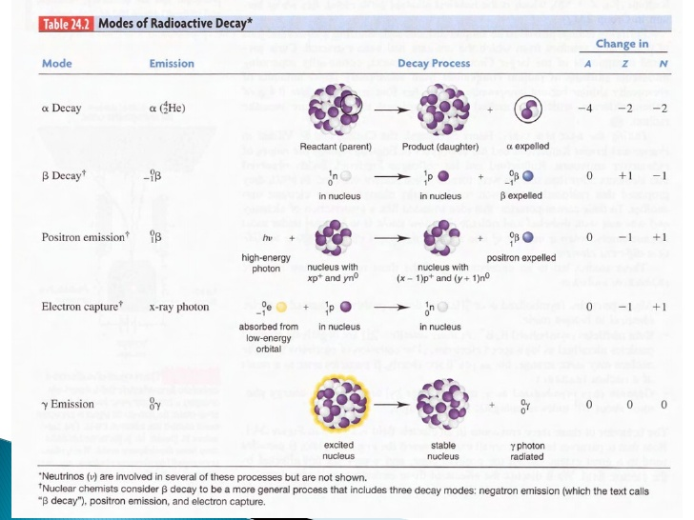

Slide 11
–
α
Lead block
γ
β
+
Radioactive substance

Slide 12
–
Lead block
+

Slide 13
–
α
Lead block
+
Radioactive substance

Slide 14
–
Lead block
β
+
Radioactive substance

Slide 15
–
Lead block
γ
+
Radioactive substance

Slide 16
–
α
Lead block
γ
β
+
Radioactive substance

Slide 17

Types of Radiation: (1)Alpha emission
Alpha emission (abbreviated as α): emission of a nucleus, or an alpha particle, from an unstable nucleus.
An example is the radioactive decay of radium-226

Slide 18
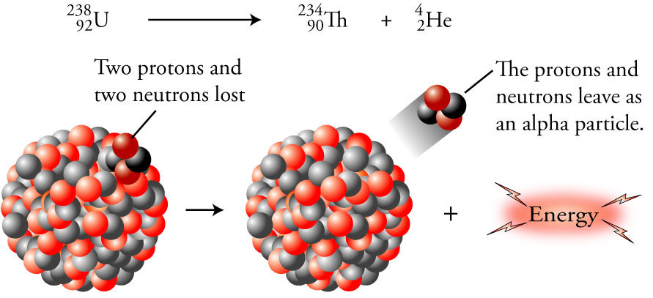

Slide 19
(2)Beta radiation
Beta emission (abbreviated β or β⁻): emission of a high speed electron from a stable nucleus.
neutron changes into proton & emits e⁻
¹₀n ⇒ ¹₁p + ⁰₋₁e
Daughter nuclide = parent nuclide atomic number plus 1
¹³⁷₅₅Cs ⇒ ¹³⁷₅₆Ba + ⁰₋₁e⁻
An example is the radioactive decay of carbon-14.

Slide 20
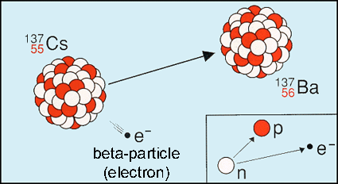

Slide 21
(3)Gamma radiation
Gamma rays are unaffected by electric and magnetic fields.
⁰₀γ
They have been shown to be a form of electromagnetic radiation similar to x rays, but higher in energy and shorter in wavelength.

Slide 22
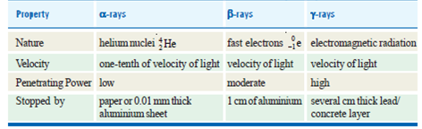
Properties and Comparison…

Slide 23

Law of Radioactive Disintegration
The decay of a radioactive isotope takes place by disintegration of the atomic nucleus. It is not influenced by any external conditions.
If N be the number of undecayed atoms of an isotope
present in a sample of the isotope, at time t,
Where means the rate of decrease in the number of radioactive atoms in the sample;
and λ is the proportionality factor. This is known as the decay constant or disintegration constant.
….(1)

Slide 24

Putting dt = 1 in equation (1) we have
Thus decay constant may be defined as the proportion of atoms of an isotope decaying per second.

Slide 25
Isotopes
The atoms of an element which have the same number of
protons and different number of neutrons are called Isotopes.
The atoms of an element which have the same atomic
number but different atomic masses or mass numbers.
Example :the isotopes of carbon (atomic number 6) having atomic masses 12 and 14 may be
written as
12 12
6 C or C or Carbon-12
14 14
6 C or C or Carbon-14

Slide 26
Isobars
The atoms which have the same mass number but different atomic numbers are called isobars.
For example,
40 40 40
18 Ar, 19K, and 20Ca are isobaric atoms.
Similarly,
235 235 235
92 U, 93 Np, and 94 Pu are isobars.

Slide 27
Isotones
Atoms which have different atomic number and different atomic masses but the same number of neutrons are called Isotones.
Examples of isotones
14 15 16
6 C, 7N and 8 O are isotones since each contains eight neutrons.

Slide 28
Half life period
The half-life, t½ ,of a radioactive nucleus is the time required for one-half of the nuclei in a sample to decay.
Half-life period is characteristic of a radioactive element.
The unit of half-life period is time– ¹.

Slide 29
For example, half-life of radium is 1620 years. This means that 1g of radium will be reduced to 0.5 g in 1620 years and to 0.25g in further 1620 years; and so on.
Some other radioactive elements may have half-life of a fraction of a second and for others it may be millions of years.

Slide 30

Half life:
Here, λ is decay constant.
Example 1.Calculate the disintegration constant of cobalt 60 if its half-life to produce nickel – 60 is 5.2 years.

Slide 31
Average life
In a radioactive substance, some atoms decay earlier and others survive longer.
The statistical average of the lives of all atoms present at any time is called the Average life.
It is denoted by the symbol τ and has been shown to be reciprocal of decay constant, λ.

Slide 32
The average life of a radioactive element is related to its half-life by the expression
Average life = 1.44 × Half-life
or τ = 1.44 × t1/2
The average life is often used to express the rate of disintegration of a radioactive element.
The average life of radium is 2400 years

Slide 33
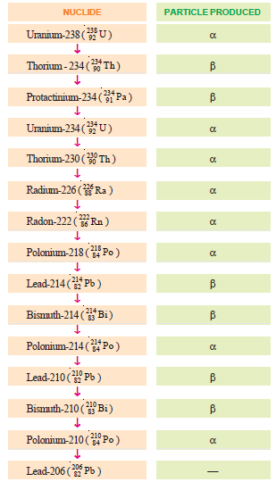
Nuclear Disintegration series

Slide 34
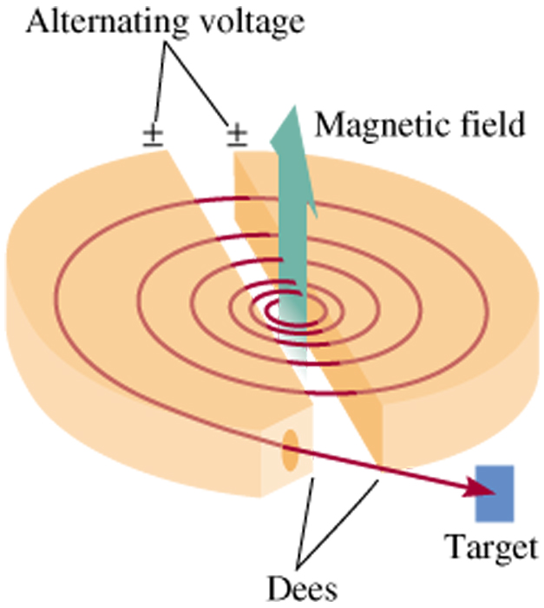
Nuclear Transmutation
¹⁴N + ⁴α ¹⁷O + ¹p
7
2
8
1
²⁷Al + ⁴α ³⁰P + ¹n
13
2
15
0
¹⁴N + ¹p ¹¹C + ⁴α
7
1
6
2
Cyclotron Particle Accelerator
23.4

Slide 35
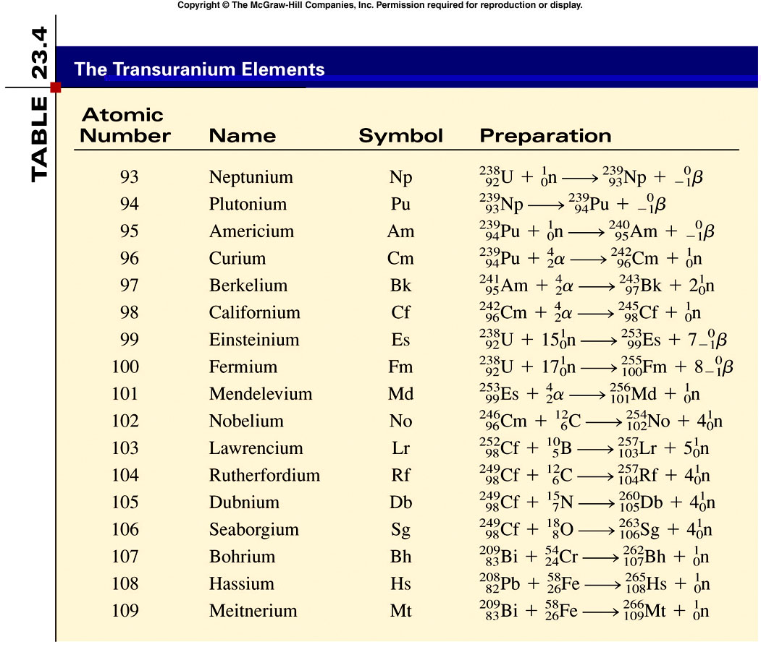
Nuclear Transmutation
23.4

